Slide 1
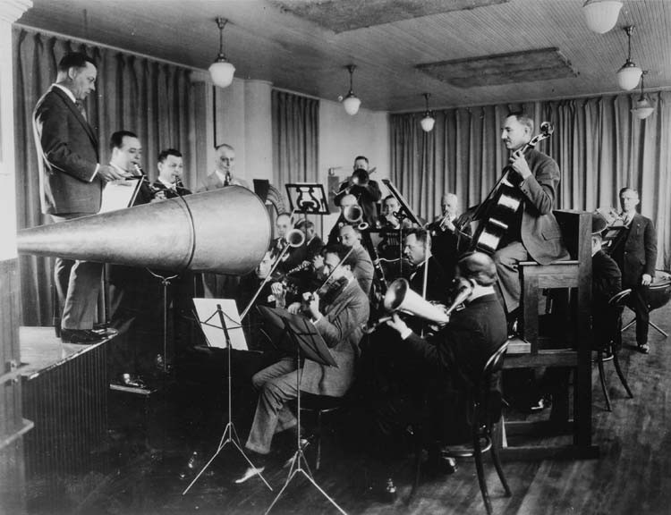
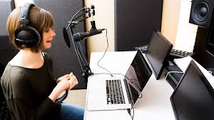
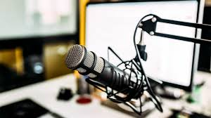
Loading, playing and recording audio
Josh Reiss
Professor of Audio Engineering
Queen Mary University of London
Blog: intelligentsoundengineering.wordpress.com/
Twitter: @IntelSoundEng
Youtube: www.youtube.com/user/IntelligentSoundEng
Publications: www.eecs.qmul.ac.uk/~josh/publications.htm

Slide 2
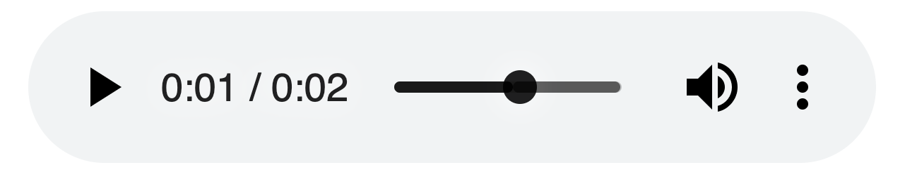
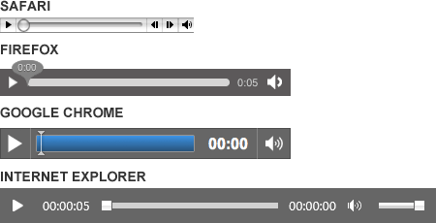
The <audio> element
Embeds sound content on web page
Buillt in buffering and streaming support
Ideal for music playback
But
No precise timing controls
Low limit for the number of sounds played at once
No way to reliably pre-buffer a sound
No ability to apply real-time effects
No way to analyze sounds

Slide 3
MediaElementAudioSourceNode
Wraps an existing <audio> or <video> tag
Behaves like other source nodes
rendered audio be re-routed
No longer be heard directly as an HTMLMediaElement
Heard as consequence of node being connected through audio graph
Other media element attributes unchanged
Pausing, volume etc behave as normal for the audio element

Slide 4
Example
Instead of <audio>, could have used
<video> as long as it has an audio stream
audio() constructor in javascript
# output channels from node equals # channels in the audio
<audio controls id='file' onplay='context.resume()'>
<source src="viper.mp3">
</audio>
<script>
context = new AudioContext()
let source = context.createMediaElementSource(file)
let gainNode = new GainNode(context,{gain:0.5})
source.connect(gainNode).connect(context.destination)
</script>
Not a scheduled source node, so don’t need start() to begin playing

Slide 5
Audio buffers
AudioBuffer stores multiple audio channels
Represented as arrays of floating-point numbers normalized between −1 and 1
new AudioBuffer(options) or context.createBuffer(nChannels,length,sampleRate)
AudioBufferSourceNode is a source node holding the in-memory audio buffer
context.createBufferSource() or new AudioBufferSourceNode(context,options)
<button id='start' onclick='context.resume()'>Make noise</button>
<script>
let i,context= new AudioContext();
let source = context.createBufferSource();
source.buffer = context.createBuffer(1, 1024,context.sampleRate);
for (i=0;i<1024;i++) source.buffer.getChannelData(0)[i] = 2*Math.random()-1;
source.start();
source.connect(context.destination);
</script>
# of channels
# of samples
Samples per second
First channel

Slide 6
Loading an audio sample
<button id="play" onclick='context.resume()'>Play</button><br>
Playback rate<input id="playRate" type="range" min=0.3 max=3 step=0.05 value=1>
<script>
let context = new AudioContext()
let source = context.createBufferSource()
source.connect(context.destination)
source.start()
request = new XMLHttpRequest()
request.open('GET','viper.mp3', true)
request.responseType = 'arraybuffer'
request.onload = () => {
context.decodeAudioData(request.response, (buffer) => { source.buffer = buffer })
}
request.send()
playRate.oninput = () => {source.playbackRate.value = playRate.value}
</script>
XMLHttpRequest to load audio sample
Audio can be any format supported by audio element
Process results with decodeAudioData
Decode the file into raw data
Make this the source node’s buffer
Load a requested file

Slide 7
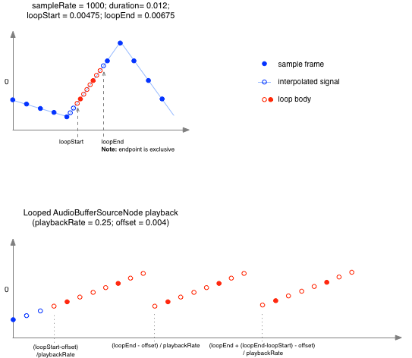
Audio buffer attributes and methods
Attributes
loop: if region of audio data between loopStart and loopEnd should keep repeating
loopEnd: position where looping ends
loopStart: position where looping begins
playbackRate: speed at which audio rendered
Methods
start(when, offset, duration):
when: time sound should start playing.
offset: position where playback will begin
duration: duration of sound to be played

Slide 8
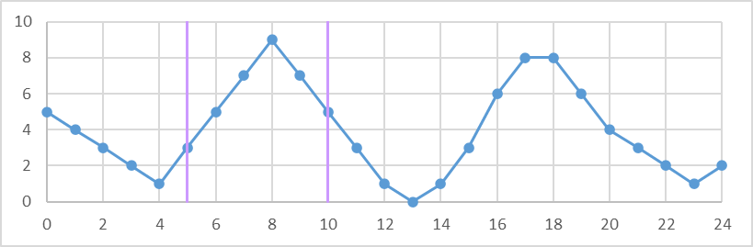
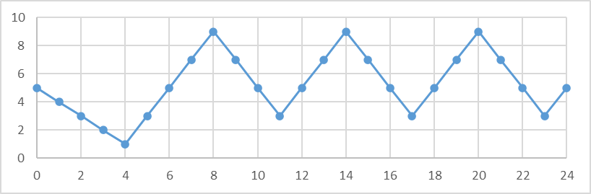
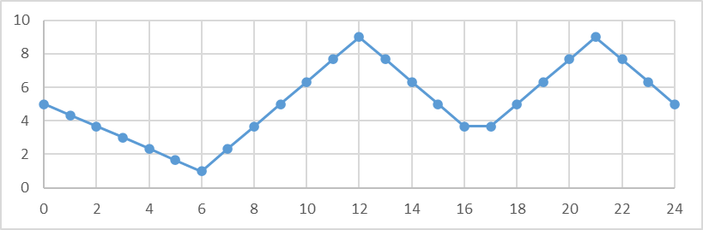
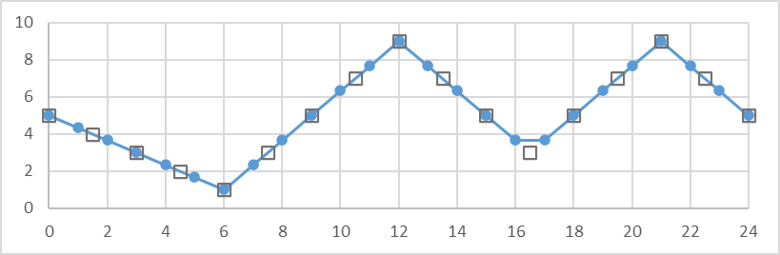
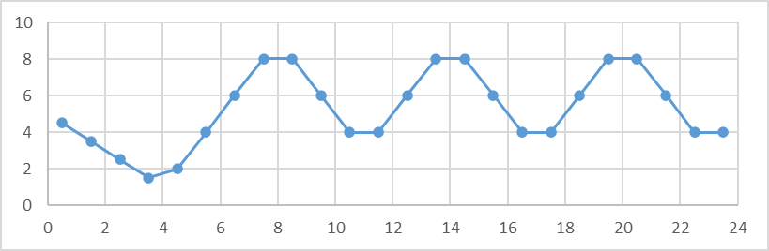
(a)
(b)
(c)
(d)
(e)

Slide 9
Recording an audio node
<button onclick="Start()">Start</button>
<button onclick="Stop()">Stop</button>
<audio controls id='audio'></audio>
<script>
var chunks = []
var context = new AudioContext()
var Tone = context.createOscillator()
var Destination = context.createMediaStreamDestination()
var Recorder = new MediaRecorder(Destination.stream)
Tone.connect(Destination)
function Start() {
Recorder.start()
Tone.start()
}
function Stop() {
Recorder.stop()
Tone.stop()
}
Recorder.ondataavailable = (evt) => {chunks.push(evt.data) }
Recorder.onstop = () => {
audio.src = URL.createObjectURL(new Blob(chunks,{'type':'audio/ogg'}))
}
</script>
MediaStreamAudioDestination routes audio to a MediaStream
Use with MediaRecorder in the MediaStream Recording API to record audio from any node
MediaRecorder does not support wav filetype, the most popular format for uncompressed audio files
Can use third party recorder.js instead
Push each chunk of data to an array
Makes URL representing an object
File-like object of raw data

